Slide 1
Optimizing Workflow Efficiency
Lakewood Resource and Referral Center
212 2nd Street Suite 204
Lakewood, New Jersey 08701

Slide 2
The Topics We’ll Be Covering
The Business Functions
Workflow Efficiency
Resources
Processes
That’s Efficiency!

Slide 3
Before We Start…
What is Efficiency?
Getting more from less
How is it Applied to Daily Operations?
Daily Operations are founded on three things.
Functions
Resources
Processes

Slide 4
Anatomy of an Agency
Functions
The Umbrella of Organizational Activities that Provide Value to the Customer
Resources
The Inputs for the Required Tasks
Processes
The Sequence of Cross Functional Inputs and Tasks that create the value for the customer

Slide 5
Functions

Slide 6
Functions
1
Inbound Logistics
2
Operations
3
Outbound Logistics
The Nine Business Functions
4
Firm Infrastructure
5
Marketing and Sales
6
Customer Service
7
Human Resources
8
Information Technology
9
Procurement

Slide 7
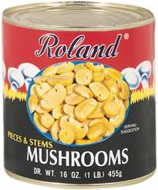
Functions
Inbound Logistics
1
Receiving
Raw Material
Storing
As Inputs to Operational Activities
Disseminating
Distribute
Some Tasks May Include…..
Can of Mushrooms comes in the soup kitchen mailbox

Slide 8
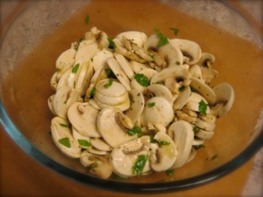
Functions
Operations
2
Inputs get transformed into finished product or service
Inputs from Inbound Logistics
Finished goods go on to outbound Logistics
Some Tasks May Include…..
Cook Creates a Mushroom Salad

Slide 9
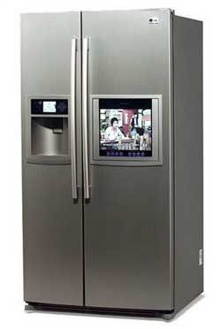
Functions
Outbound Logistics
3
Finished Goods
Warehousing
Distribution
Some Tasks May Include…..
Mushroom Salad Gets Placed in Fridge to be stored for Dinner

Slide 10
Functions
Marketing and Sales
4
Customer
Needs Identification
Generation of Sales
Some Tasks May Include…..
Locate the customer and encourage to attend and eat dinner

Slide 11
Functions
Customer Service
5
Support for Customers after product is Consumed
Some Tasks May Include…..
Provide the Visitor with Support and Encouragement

Slide 12
Functions
Firm Infrastructure
6
Management Structure
Control Systems
(Legal, Financial, Risk, Managerial)
Financial Structure
Some Tasks May Include…..
Establish and maintain the Organization’s Non Profit Status

Slide 13
Functions
Human Resources
7
Employee Recruitment
Hiring
Training
Development
Talent Management
Some Tasks May Include…..
Recruiting Volunteers to Serve the Mushroom Salad

Slide 14
Functions
Technology Development
8
Technological Systems that can add Marginal Value
Some Tasks May Include…..
Electricity for the Fridge

Slide 15
Functions
Procurement
9
Purchasing Inputs such as Materials, Supplies and Equipment
Some Tasks May Include…..
Purchasing the Fridge

Slide 16
Functions
Firm Infrastructure
Support
Human Resources
Tech Infrastructure
Core
Procurement
Inbound Logistics
Operations
Outbound Logistics
Sales
Service

Slide 17
Functions
Value Chain - How it all comes together
Support Functions
Firm Infrastructure
Margin of Value
Human Resources
Procurement
Information Technology
Inbound Logistics
Operations
Outbound Logistics
Marketing and Sales
Customer Support
Core Functions

Slide 18
Functions
Categories in the Value Chain
Firm Infrastructure
Margin of Value
Human Resources
Procurement
Information Technology
Enterprise Resource Planning
Inbound Logistics
Operations
Outbound Logistics
Marketing and Sales
Customer Support
Supply Chain Management
Customer Relationship Management

Slide 19
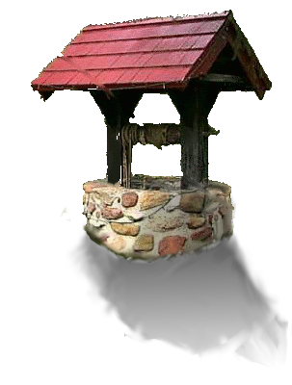
Resources

Slide 20
Resources
Resources - the Available Inputs for Functions
Physical
Financial
Inputs
Four Categories
Social
Intellectual

Slide 21
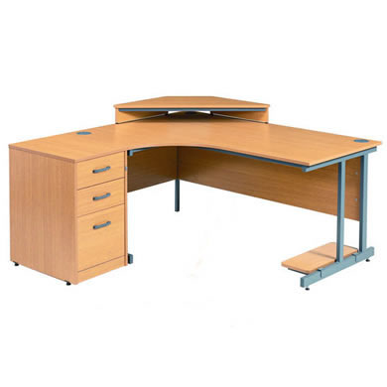
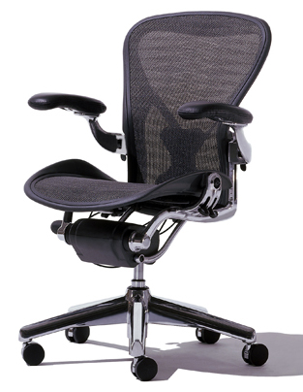
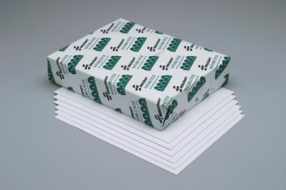
Resources
Physical
Anything Tangible

Slide 22
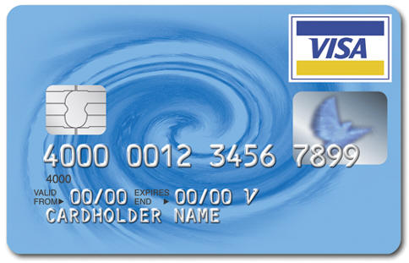
Resources
Financial
Financial Sponsors
Loans

Slide 23
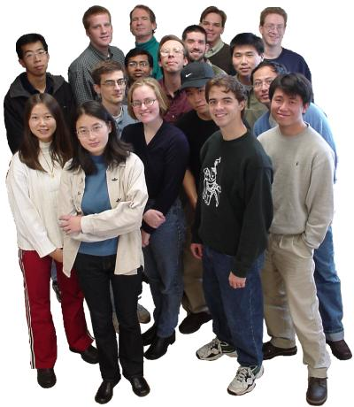
Resources
Social
People
Trust
Talent
Community Image

Slide 24
Resources
Intellectual
Patents
Employee Intelligence
Community Insight

Slide 25
Resources
Resource – Its the only thing anyone can use to create value.
Physical
Financial
Resources pass through the functions and are distributed to the Processes
Social
Intellectual

Slide 26
Processes

Slide 27
Processes
PROCESSES - How the agency accomplishes it’s goals
MANAGEMENT PROCESSES
OPERATIONAL PROCESSES
Efficient Structure
SUPPORT PROCESSES

Slide 28
Processes
The Logic Model
Inputs
Outputs
Outcomes
Impact
Current Circumstance
Desired Circumstance
Unhappy & Unproductive with a headache
Happy & Productive
Tylenol & Cup of Water
Tylenol
Can be consumed
Headache is Gone
Happy & Productive

Slide 29
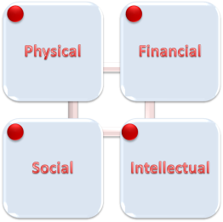
Processes
MANAGEMENT PROCESSES
The Processes that develop the strategy
Some Management Processes May Be….
Corporate Governance
Strategic Planning
Risk Management

Slide 30
Processes
MANAGEMENT PROCESSES
Inputs
Outputs
Outcomes
Impact
Lapse in Management
Solidified Management
All Dept. Heads and facility to meet and discuss.
Discovery of managerial lapses
Management Procedures developed
Enhanced Management

Slide 31
Processes
OPERATIONAL PROCESSES
The Processes that Implement the Strategy
Some Operational Processes May Be….
Production Processes
Distribution Processes

Slide 32
Processes
OPERATIONAL PROCESSES
Inputs
Outputs
Outcomes
Impact
Employee’s come in late
Employees Come on time
Time clock
Training for time clock
Employees can document the time they come in
Employees get paid for the time they work
Enhanced Management

Slide 33
Processes
SUPPORT PROCESSES
The Processes that Support the Operational Processes
Some Support Processes May Be….
Tech Support
Accounting
Call Center

Slide 34
Processes
SUPPORT PROCESSES
Inputs
Outputs
Outcomes
Impact
No Time Clock Employees Can’t Clock In
Employees Can Clock In
Time clock
Tech to install time clock
Employees can clock in
Time clock is installed
Time can be calculated

Slide 35
Processes
Efficient Structure
Inputs
Outputs
Outcomes
Impact
Lowest Level of Input for Maximum Level of Output

Slide 36
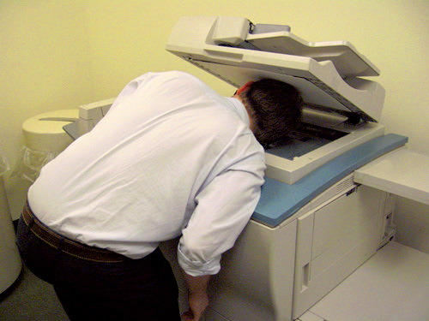
Designing Efficient Processes

Slide 37
1
That’s Efficiency
Six Questions
What is needed
When is it needed
Where is it needed
How is it needed
Why is it needed
Who is needed
Lowest Level of Input for Maximum Level of Output

Slide 38
2
That’s Efficiency
Business Process Management
Design
Model
Focus on developing the process
Execute
Monitor
Optimize

Slide 39
3
That’s Efficiency
Six Sigma
Define
Measure
Focus on Optimizing the Value Chain
Analyze
Design
Verify

Slide 40
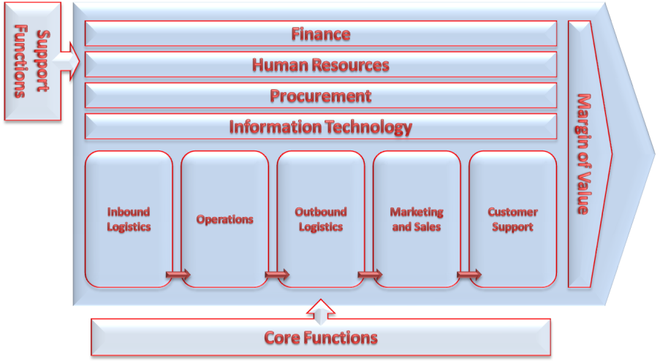
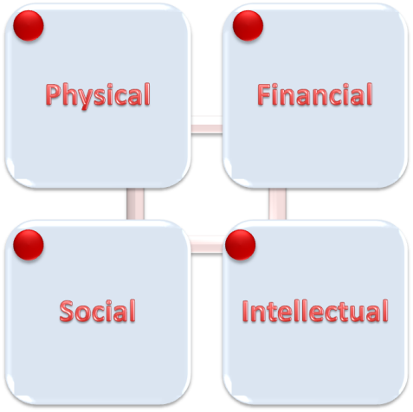
How it all comes together

Slide 41
How it all comes together

Slide 42
Summing it all up
Functions
Resources
Processes
Efficiency

Slide 43
Thank You!
Q&A

